Slide 1
Optimizing SparkSQL for Interactive Analysis

Slide 2
Agenda
SQL-on Hadoop background
Spark SQL high level Architecture
Spark SQL optimization
Future plan, Challenges and Opportunities

Slide 3
SQL on Hadoop
Background
offloading Teradata and moving to Hadoop
Challenges and Gap
Easy to use
Query Performance
Easy to tune, Adaptive optimization
Update/Delete support
Data Security
Workload management
Our Goal

Slide 4
The High-Level Architecture of Carmel
JDBC/ODBC
UI
SQL on Hadoop
Hadoop
Gateway
Tenant A
Tenant B
Tenant C
LB
……
UI
Gateway
Hive Metastore
Tableau
SSD
HDD
VDM
Prod DBs
Shuffle
Cache
……
Gateway
Hadoop
Hadoop

Slide 5
Spark SQL Optimization
Long Running Cluster of Thrift servers
Spark Driver Optimization
Bucketing
Better data placement – Range Partition + Bucketing
Caches
Data Security
Spark Adaptive Execution
Index

Slide 6
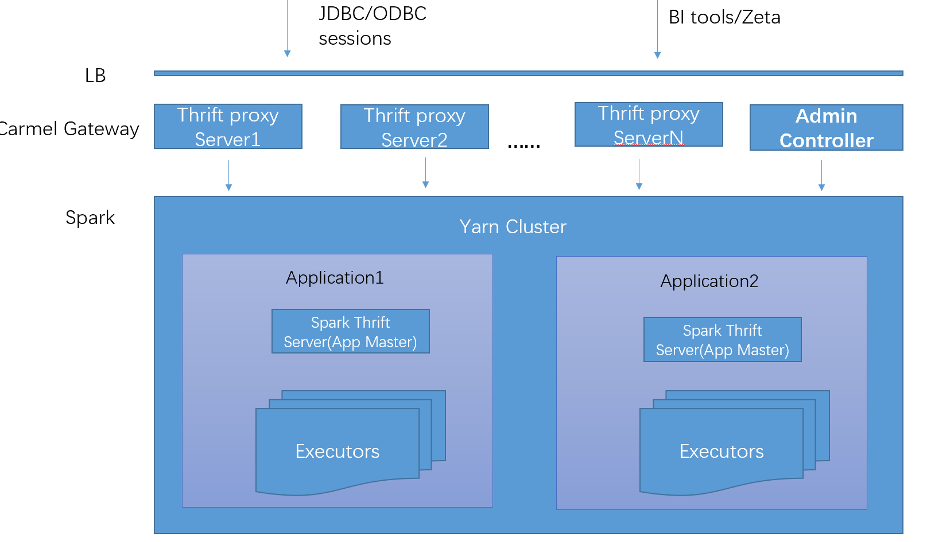
Long running cluster of Thrift Servers
Carmel Gateway
Spark Thrift Servers on Yarn
Support multiple Authentications
Impersonation
Automatic session dispatch
Standard JDBC driver
Mac/Linux/Windows ODBC drivers
Monitoring and Alerting
System Audit table to record query behaviors
Long running query detection

Slide 7
Spark Driver Optimization
New Task Scheduler Implementation
- Optimized for concurrency and throughput
Large query result spill to disk
Fix memory leaks in Spark Thrift Server and Driver
Cache
Query Dumper, easy for query plan debug
Spark History server
- Log files organized by session
- On demand load by sessionid

Slide 8
Concurrency/Throughput Test
Test on local HDFS with SSD, Executors num = 850
Client Nums | Throughput (sqls/min) | Avg Latency(ms) | Table Type
15 | 37.8 | 22583 | Partition
20 | 34.8 | 32106 | Partition
25 | 35.4 | 41774 | Partition
Client Nums | Throughput (sqls/min) | Avg Latency(ms) | Table Type
40 | 75 | 30207 | Partition
40 | 115.2 | 20317 | RangePartition + Bucket
2x throughput

Slide 9
Bucket Join
Spark SQL Bucket Table Join
Require:
hash partitioning
Sort by join key
SortMergeJoin
SortMergeJoin
If join on bucket column
Physical Optimize
SortExec
SortExec
ShuffleExchangeExec
ShuffleExchangeExec
TableScanExecA
TableScanExecB
Output:
Hash partitioned by bucket columns
Sorted by bucket column
TableScanExecA
TableScanExecB

Slide 10
Bucket join
One bucket only generate one file
Default Sort by bucket column
Indexed bucket
Support multiple bucketing number
Support Join keys are the super set of bucket keys
Partial Sorted RDD, move sort to RDD scan
Does not support Hive bucket

Slide 11
Combine Bucket and Partition?
Bucketing is good for large tables join, partitioning is good
for data prune and data refreshment, can we combine them?
Usually you can’t, partition + bucket will generate (M*N) number of tiny HDFS files and kill the Hadoop NN.

Slide 12
A better data placement – Range Partition + Bucket
Range partition can provide the flexibility to better manage the partition base on needs.
18 * 365 * n
17 * n + 12 * n
Partition
2000-01-01
2000-01-02
2017-12-31
2000-01-01
2000-12-31
2001-01-01
2001-12-31
2017-12-01
2017-12-31
Bucket-1
Bucket-1
Bucket-1
Bucket-1
Bucket-1
Bucket-1
Bucket-2
Bucket-2
…
Bucket-2
Bucket-2
Bucket-2
…
Bucket-2
Bucket
Bucket-3
Bucket-3
Bucket-3
Bucket-3
Bucket-3
Bucket-3
……
……
……
……
……
……
Bucket-n
Bucket-n
Bucket-n
Bucket-n
Bucket-n
Bucket-n
With Range partition + bucket, we can also apply Dynamic Partition Prune(Spark 3.0) to the bucket table.

Slide 13
Range Partitions
Range PARTITION DDL
Benchmark result
create ebay_range.dw_lstg_item
PARTITIONED BY RANGE (AUCT_END_DT DATE)
(
PARTITION p_20050101 VALUES LESS THAN ('2005-01-01'),
PARTITION p_20060101 VALUES LESS THAN ('2006-01-01'),
PARTITION p_20070101 VALUES LESS THAN ('2007-01-01'),
PARTITION p_20080101 VALUES LESS THAN ('2008-01-01'),
PARTITION p_20090101 VALUES LESS THAN ('2009-01-01'),
PARTITION p_20100101 VALUES LESS THAN ('2010-01-01'),
PARTITION p_20110101 VALUES LESS THAN ('2011-01-01'),
PARTITION p_20120101 VALUES LESS THAN ('2012-01-01'),
PARTITION p_20130101 VALUES LESS THAN ('2013-01-01'),
PARTITION p_20140101 VALUES LESS THAN ('2014-01-01'),
PARTITION p_20150101 VALUES LESS THAN ('2015-01-01'),
PARTITION p_20160101 VALUES LESS THAN ('2016-01-01'),
PARTITION p_20170101 VALUES LESS THAN ('2017-01-01'),
PARTITION p_20180101 VALUES LESS THAN ('2018-01-01'),
PARTITION p_20190101 VALUES LESS THAN ('2019-01-01'),
PARTITION p_20200101 VALUES LESS THAN ('2020-01-01'),
PARTITION p_99991231 VALUES LESS THAN ('9999-12-31')
)
CLUSTERED BY (ITEM_ID)
SORTED BY (ITEM_ID, AUCT_END_DT)
INTO 1000 BUCKETS AS
select * from access_views.dw_lstg_item;
Query | RB |  |  | IB
 | Run 1 | Run 2 | Run 3 | Run 1 | Run 2 | Run 3
q1 | 30667 | 9385 | 8566 | 29676 | 110543 | 26205
q2 | 15225 | 9639 | 10166 | 19998 | 20427 | 16260
q3 | 15093 | 12122 | 13068 | 31320 | 37314 | 26412
q4 | 15034 | 11543 | 10800 | 18280 | 17564 | 16217
q5 | 4847 | 4017 | 4622 | 8845 | 9157 | 9268
q6 | 16941 | 8062 | 7576 | 24141 | 26178 | 20375
q7 | 9772 | 8160 | 7278 | 25490 | 28394 | 24386
q8 | 9389 | 5140 | 4623 | 12845 | 14457 | 11050
q9 | 4179 | 3273 | 3170 | 9795 | 10123 | 9240
q10 | 10121 | 4966 | 4826 | 13778 | 11854 | 10706
q11 | 7867 | 6633 | 5932 | 22442 | 24968 | 21133
q12 | 5403 | 6394 | 6368 | 12806 | 11369 | 12082
q13 | 10866 | 6640 | 5272 | 13602 | 13439 | 11617
q14 | 12471 | 8764 | 8272 | 17182 | 14977 | 14538
q15 | 5984 | 7459 | 5626 | 9625 | 9032 | 10147
q16 | 9822 | 8086 | 8036 | 14772 | 16758 | 14726
q18 | 6223 | 6501 | 5768 | 12919 | 12329 | 12541
q19 | 10738 | 7766 | 8254 | 19342 | 16175 | 14469
q20 | 6066 | 5951 | 5836 | 15489 | 12777 | 11675
q22 | 2721 | 2946 | 2422 | 7917 | 7653 | 7245
q23 | 8972 | 22132 | 8089 | 24636 | 20007 | 20439
q28 | 9367 | 8629 | 8745 | 15229 | 16969 | 14250
q30 | 20940 | 18554 | 28292 | 20343 | 46132 | 18715
q35 | 11611 | 9166 | 9280 | 11282 | 8608 | 8215
q36 | 8483 | 8496 | 7886 | 8016 | 7208 | 8217
q57 | 3500 | 3841 | 3667 | 9499 | 9360 | 9422
q58 | 3620 | 4375 | 4156 | 9424 | 9439 | 9040
q59 | 7593 | 8455 | 8437 | 23694 | 20757 | 18963
q60 | 10668 | 10273 | 9202 | 56688 | 30424 | 25992
q66 | 28232 | 11891 | 10953 | 31305 | 16917 | 16214
sum | 323135 | 249784 | 235729 | 550909 | 611884 | 450278

Slide 14
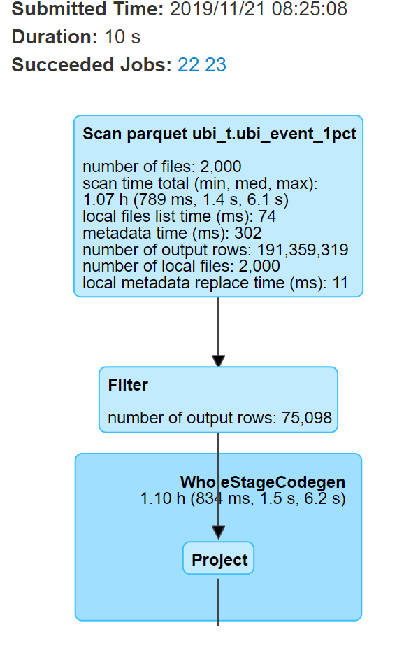
Caches
Data Cache
- Cache remote hot tables to local SSD
Statement level metadata Cache
Spark Broadcast Cache
Cross session Hive metadata Cache(Working on)
Relational Cache/Materialize View(Working on)

Slide 15
Relation Cache/MV
Cache and reuse the common query pattern to avoid duplicate calculate
pre-calculation to accelerate the query, make the answer more close to the query.
Flexible way to change the data placement, transparent to upstream and downstream
Need to implement a query rewriter in logical optimize phase to rewrite logical plan.
Refer to Oracle MV rewriter design.
A
query
query
query
F
Aggregate Compatibility
Check
query
F
Join
Compatibility
Check
Data Sufficiency
Check
…...
Find common subgraph
Rewrite with additional filter
Rewrite with additional aggregate
MV
MV
MV
MV

Slide 16
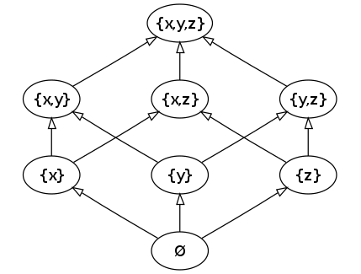
Relation Cache Query Rewriter
Join Compatibility Check
Inner join can derive from outer join by filtering anti-join rows
…...
Data Sufficiency Check
id=102
id between 1 and 100
id>10 and id<50
id in (20,30,40)
…...
Group Compatibility Check
Aggregate Compatibility Check
Lattice for MV dependencies
CREATE MATERIALIZED VIEW sum_sales_time_product_mv SELECT mv.prod_name,SUM(mv.amount_sold) FROM join_sales_time_product_mv mv GROUP BY mv.prod_name;

Slide 17
Data Security
SQL/View based access control
- Grant/Revoke/Role Syntax support
Transparent column level encryption/decryption
- Parquet column encryption/decryption
- Parquet footer encryption/decryption
- Key Management service
Define and manage the same Access Bundle in Hadoop
as Teradata
View level Access
Access Views
Table level Access
Hive/Spark Tables
File level Access
HDFS File

Slide 18
Spark Adaptive Execution
A Must have for long running clusters
Enabled by default for all the queues/tenants
Implement Skewed join based on new AE framework in Spark 3.0
Support 3 table skew joins
Improve Driver memory usage for UnionRDD
Optimization for NAAJ(Null-Aware-Anti-Join)
Optimization for Create/Insert
Limit query optimization, do not submit all the tasks.

Slide 19
Future work
Automated MV/Index/Cache life cycle management
CBO Stats collecting automation
Range Filter Simplify
Infer additional Filters from constraints and pushdown
Join pushdown(Adaptive Runtime filter)
Skewed join hint
Support Dela Lake
UDF performance
….

Slide 20
Challenges and Opportunities
Workload management
Teradata has very solid workload management
CBO, new CBO framework
CBO can do more besides Join reordering
Volcano/Cascade style cost based optimization framework commonly adopted by
many DB engines(SQL Server, Greenplum Orca, Apache Calcite…)
Solid Stats derivation, more accurate cost model
Adaptive Execution
AE can be more adaptive

Slide 21
Thanks you
Q & A

